Slide 1
// When I wrote this, only God and I understood what I was doing // Now, God only knows // Magic. Do not touch. // somedev1 - 6/7/02 Adding temporary tracking of Login screen // somedev2 - 5/22/07 Temporary my ass <!-- Here be dragons --> // I am not responsible of this code. They made me write it, against my will. // Dear future me. Please forgive me. I can't even begin to express how sorry I am. // no comments for you. it was hard to write so it should be hard to read // John! If you'll svn remove this once more, I'll shut you, for God's sake! // That piece of code is not “something strange”! That is THE AUTH VALIDATION. // This procedure is really good for your dorsolateral prefrontal cortex. // Abandon all hope ye who enter beyond this point // Catching exceptions is for communists // Peter wrote this, nobody knows what it does, don't change it! // if i ever see this again i'm going to start bringing guns to work
// Happy debugging, suckers
const int TEN=10; // As if the value of 10 will fluctuate...
Notes:
http://stackoverflow.com/questions/184618/what-is-the-best-comment-in-source-code-you-have-ever-encountered

Slide 2

Evosoft Hungary Mind That Code

Slide 3

Code maintenance costs
Why Clean Code is important?
Clean Code principles

Slide 4
Code maintenance costs
Notes:
“There are 100 different features we could work on today, but we only have the manpower to work on 2. Which ones should we work on first?”

Slide 5
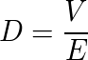
Code maintenance costs
The Equation of Software Design:
D - Desirability V - Value E - Effort
Notes:
Desirability: How much do we want to do something?
Value: How much does this help our users?
Effort: How much work will the change require?

Slide 6
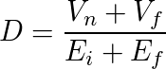
Code maintenance costs
The Equation of Software Design:
D - Desirability Vn - Value now Vf - Future value Ei - Effort of implementation Em - Effort of maintenance
Notes:
The equation as we have it so far is very simple, but it is missing an important element —time. Not only do you have to implement a change, but you also have to maintain it over time.
Some features even change in value over time.

Slide 7
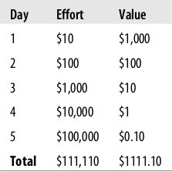
Code maintenance costs
The Equation of Software Design:
D - Desirability Vn - Value now Vf - Future value Ei - Effort of implementation Em - Effort of maintenance
Notes:
The primary lesson to learn here is that we want to avoid situations where, for a given change, the effort of maintenance will eventually outweigh the future value.

Slide 8
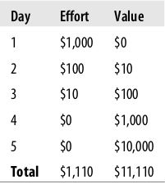
Code maintenance costs
The Equation of Software Design:
D - Desirability Vn - Value now Vf - Future value Ei - Effort of implementation Em - Effort of maintenance
Notes:
The ideal solution—and the only way to guarantee success—is to design your systems such that the effort of maintenance decreases over time, and eventually becomes zero (or as close to it as possible).

Slide 9
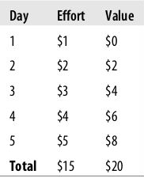
Code maintenance costs
The Equation of Software Design:
D - Desirability Vn - Value now Vf - Future value Ei - Effort of implementation Em - Effort of maintenance
Notes:
Theoretically, as long as the future value is always larger than the maintenance effort, the change is still desirable. So, you could make some change where the maintenance effort and the future value both increased, as long as the future value kept on being large enough to outweigh the effort of maintenance.
It is more important to reduce the effort of maintenance than it is to reduce the effort of implementation.

Slide 10
Eu - Effort of understanding Ec - Effort of changing Et - Effort of testing Ed - Effort of deploying

Slide 11
Eu - Effort of understanding Ec - Effort of changing Et - Effort of testing Ed - Effort of deploying
Notes:
Maintenance is expensive because understanding existing code is time consuming and error-prone. Making changes is generally easy when you know what needs changing. Learning what the current code does is the expensive part. Once the changes are made, they need to be tested and deployed.

Slide 12
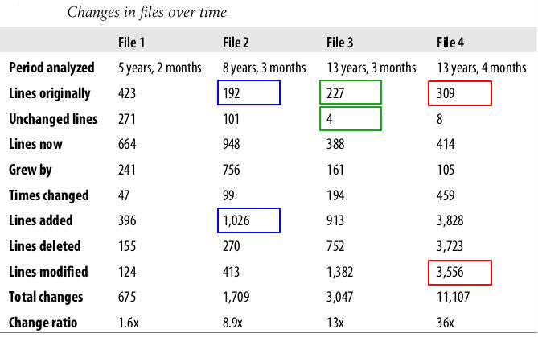
Notes:
Period analyzed - The time period over which the file existed.
Lines originally - How many lines were in the file when it was originally written.
Unchanged lines - How many lines are the same now as they were when the file was originally written.
Lines now - How many lines there are in the file now, at the end of the analysis period.
Grew by - The difference between “Lines now” and “Lines originally.”
Times changed - The total number of times a programmer made some set of changes to the file (where one set of changes involves changes to many lines). Usually one set of changes will represent one bug fix, one new feature, etc.
Lines added - How many times, over the history of the file, a new line was added.
Lines deleted - How many times, over the history of the file, an existing line was deleted.
Lines modified - How many times, over the history of the file, an existing line was changed (but not newly added or deleted).
Total changes - The sum of the “Lines added,” “Lines deleted,” and “Lines modified” counts for that file.
Change ratio - How much larger “Total changes” is than “Lines originally.”

Slide 13
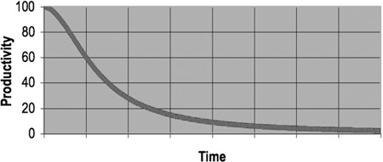
When software is hard to create or modify, programmers spend most of their time focusing on making things “just work,” and less time focusing on helping the user.
Notes:
The easier it is to maintain a piece of software, the easier it is for the programmers to ensure that the software continues to be helpful.
As the mess builds, the productivity of the team continues to decrease, asymptotically approaching zero. As productivity decreases, management does the only thing they can; they add more staff to the project in hopes of increasing productivity. But that new staff is not versed in the design of the system. They don’t know the difference between a change that matches the design intent and a change that thwarts the design intent. Furthermore, they, and everyone else on the team, are under horrific pressure to increase productivity. So they all make more and more messes, driving the productivity ever further toward zero.
This is how we make a lot of technical debts.

Slide 14
When software is hard to create or modify, programmers spend most of their time focusing on making things “just work,” and less time focusing on helping the user.
This leads to technical debts!
Notes:
This is how we make a lot of technical debts.

Slide 15
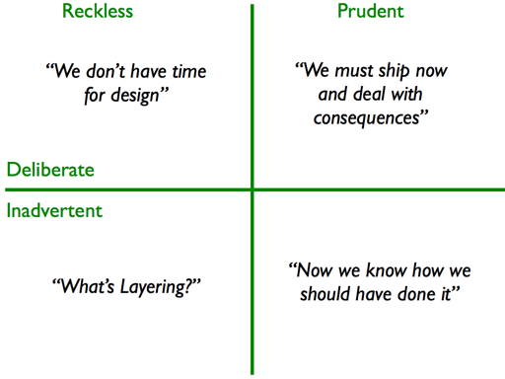
Why Clean Code is important?
The Technical Debt Quadrant:
Notes:
http://martinfowler.com/bliki/TechnicalDebtQuadrant.html
The term Technical Debt was created by Ward Cunningham to describe the engineering trade-off’s that software developers and business stakeholders must often make in order to meet schedules and customer expectations.
Like a financial debt, the technical debt incurs interest payments, which come in the form of the extra effort that we have to do in future development because of the quick and dirty design choice.
A mess is a reckless debt which results in crippling interest payments or a long period of paying down the principal.
The prudent debt to reach a release may not be worth paying down if the interest payments are sufficiently small - such as if it were in a rarely touched part of the code-base.
The moment you realize what the design should have been, you also realize that you have an inadvertent debt.
Inadvertent debt may come from ignorance. If you learn it can turn to Prudent debt.
----
reckless = meggondolatlan
prudent = óvatos
deliberate = szándékos
inadvertent = gondatlan

Slide 16
LeBlanc’s law:
later = NEVER

Slide 17
LeBlanc’s law:
later = NEVER
This is how the software starts to rot!
Notes:
Software rot, also known as code rot, bit rot, software erosion, software decay or software entropy describes the perceived "rot" which is either a slow deterioration of software performance over time or its diminishing responsiveness that will eventually lead to software becoming faulty, unusable, or otherwise called "legacy" and in need of upgrade. This is not a physical phenomenon: the software does not actually decay, but rather suffers from a lack of being responsive and updated with respect to the changing environment in which it resides.
The code gets more and more bugs introduced to it over time. Worse, it tends to get more and more "correct but ugly/hacky" code. This reduces the integrity of the code, "rotting" it until it eventually falls apart.

Slide 18
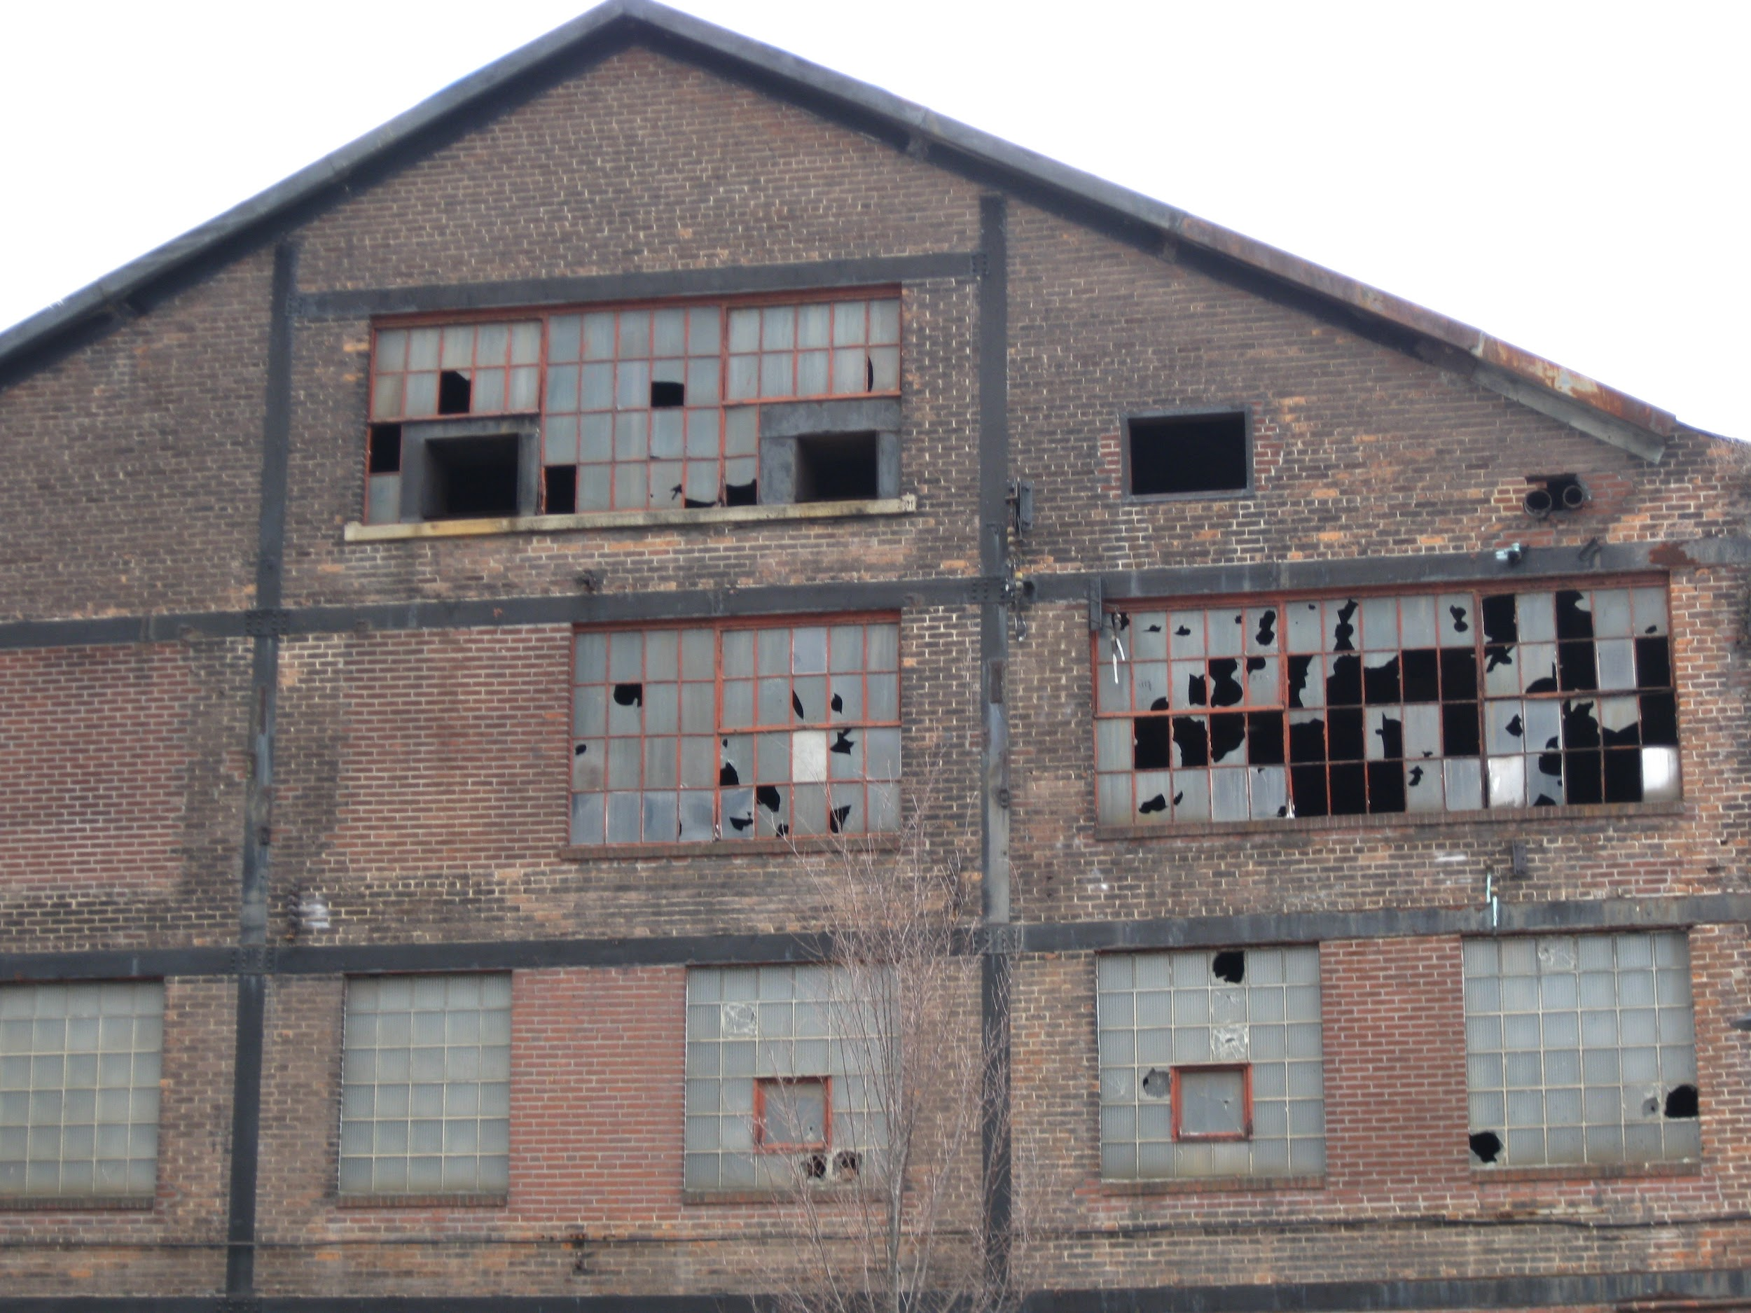
LeBlanc’s law:
later = NEVER
This is how the software starts to rot!
The Broken Window Theory:
Notes:
Broken window theory - 1982
Consider a building with a few broken windows. If the windows are not repaired, the tendency is for vandals to break a few more windows. Eventually, they may even break into the building, and if it's unoccupied, perhaps become squatters or light fires inside.
Or consider a pavement. Some litter accumulates. Soon, more litter accumulates. Eventually, people even start leaving bags of refuse from take-out restaurants there or even break into cars.
https://en.wikipedia.org/wiki/Broken_windows_theory

Slide 19
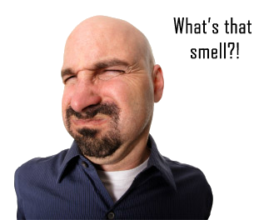
Code smell
Duplicated code Large class Cyclomatic complexity Downcasting Too many parameters Long method Big ball of mud Circular dependency Lasagna code Spaghetti code | Copy and paste programming Premature optimization Reinventing the square wheel Tester Driven Development God object Magic numbers
Notes:
Martin Fowler, "a code smell is a surface indication that usually corresponds to a deeper problem in the system".
"smells are certain structures in the code that indicate violation of fundamental design principles and negatively impact design quality". Code smells are usually not bugs—they are not technically incorrect and do not currently prevent the program from functioning. Instead, they indicate weaknesses in design that may be slowing down development or increasing the risk of bugs or failures in the future. Bad code smells are an important reason for technical debt.
https://en.wikipedia.org/wiki/Code_smell
https://en.wikipedia.org/wiki/Anti-pattern

Slide 20
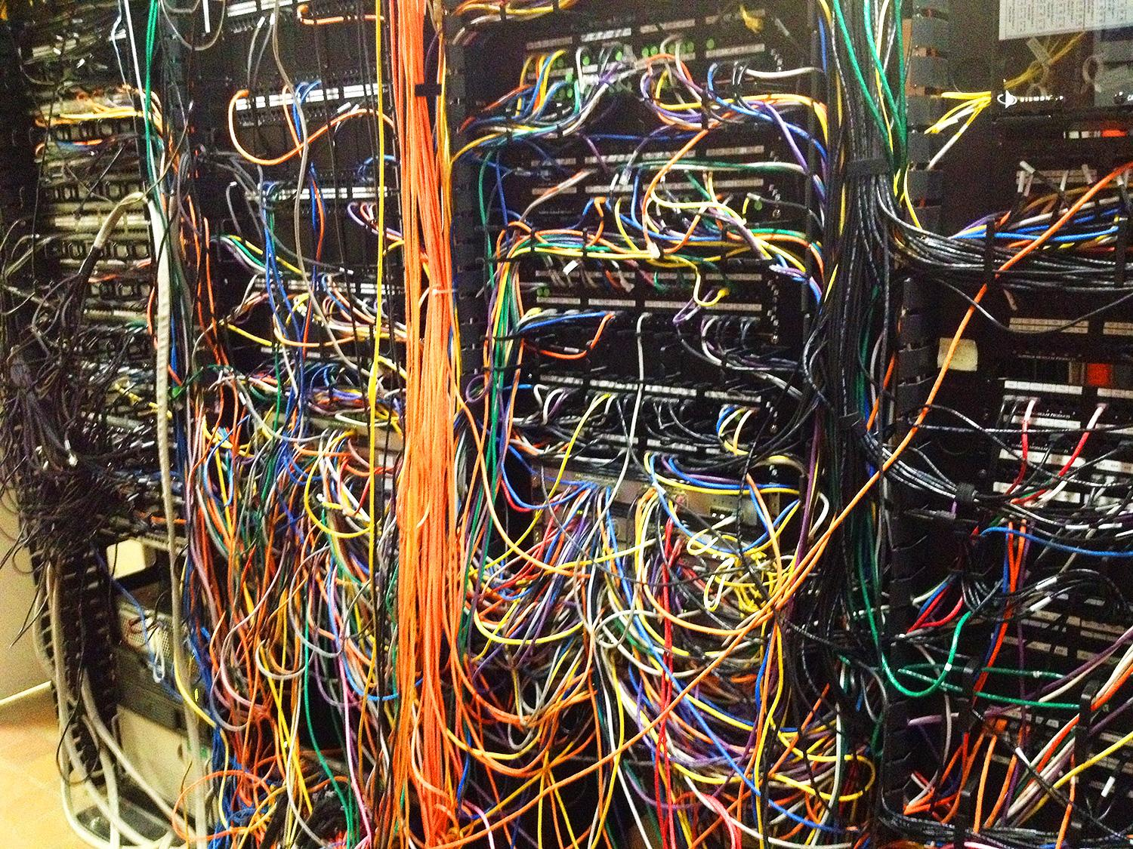
A messy source code can FAIL your project!
Notes:
You will not make the deadline by making the mess. Indeed, the mess will slow you down instantly, and will force you to miss the deadline.
Systems fail because they are complex. Reduce the complexity to have an easily understandable system.

Slide 21
Rushing makes you write bad code.
What are the reasons to rush?

Slide 22
Rushing makes you write bad code.
What are the reasons to rush?
managers

Slide 23
Rushing makes you write bad code.
What are the reasons to rush?
managers
customers

Slide 24
Rushing makes you write bad code.
What are the reasons to rush?
managers
customers
impossible schedules

Slide 25
Rushing makes you write bad code.
What are the reasons to rush?
managers
customers
impossible schedules
always changing requirements

Slide 26

Rushing makes you write bad code.
What are the reasons to rush?
managers
customers
impossible schedules
always changing requirements

Slide 27
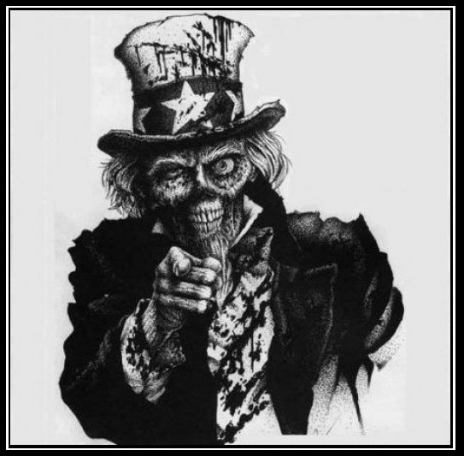
Notes:
We are unprofessional. This may be a bitter pill to swallow. How could this mess be our fault? What about the requirements? What about the schedule? What about the stupid managers and the useless marketing types? Don’t they bear some of the blame? No. The managers and marketers look to us for the information they need to make promises and commitments; and even when they don’t look to us, we should not be shy about telling them what we think. The users look to us to validate the way the requirements will fit into the system. The project managers look to us to help work out the schedule.

Slide 28
What if we could increase the productive time
by decreasing the time of reading and understanding source code?
read less
write more
Notes:
You lose time because it will be hard to understand what is in the code. Even new people will bother you to ask questions about your code. If a code is not easy to understand you can even break something on refactoring (you change it because bad naming can fool you) afterwards you need extra time to debug what was broken and where to fix.
Stop wasting someone else's time by saving your time to find a proper naming and write clean code.

Slide 29
How fast can you read the sentence below?
tHisisanOrmalseNtencewitHnorMalwordsthAtevErybOdycAnunderStaNd.

Slide 30
What about this?
This is a normal sentence with normal words that everybody can understand.

Slide 31

Smart developers write code only they can understand.
Notes:
Now, programmers are generally an intelligent bunch. But it’s still a mistake to think, “Oh, other programmers will understand everything I’ve done here without any simplification or explanation of my code.” It’s not a matter of intelligence—it’s a matter of knowledge. Programmers who are new to your code don’t know anything about it; they have to learn. The easier you make it for them to learn, the faster they are going to figure it out, and the easier it will be for them to use it.

Slide 32
Smart developers write code only they can understand.
Professionals write clean code!
Notes:
The Law of Simplicity: The ease of maintenance of any piece of software is proportional to the simplicity of its individual pieces. -- an average-sized computer program is so complex that no human being could comprehend it all at once. It’s only possible to comprehend pieces of it.
So, a “good programmer” should do everything in his power to make what he writes as simple as possible to other programmers.
Spending a little more time writing simple code turns out to be faster than writing lots of code quickly at the beginning and then spending a lot of time trying to understand it later.
Spending time keeping your code clean is not just cost effective; it’s a matter of professional survival.
The immediate benefits of clear code are fewer defects, easier sharing of code, and smoother development.

Slide 33
You are an @author who is responsible for communicating well with his readers.
Notes:
The @author field of a Javadoc tells us who we are. We are authors. And one thing about authors is that they have readers. Indeed, authors are responsible for communicating well with their readers. The next time you write a line of code, remember you are an author, writing for readers who will judge your effort.
no code ownership, like zero bug culture, pair programing and strict TDD

Slide 34
You are an @author who is responsible for communicating well with his readers.
Making it easy to read actually makes it easier to write.
Notes:
It’s not enough to write the code well. The code has to be kept clean over time. We’ve all seen code rot and degrade as time passes. So we must take an active role in preventing this degradation. The Boy Scouts of America have a simple rule that we can apply to our profession. Leave the campground cleaner than you found it.

Slide 35
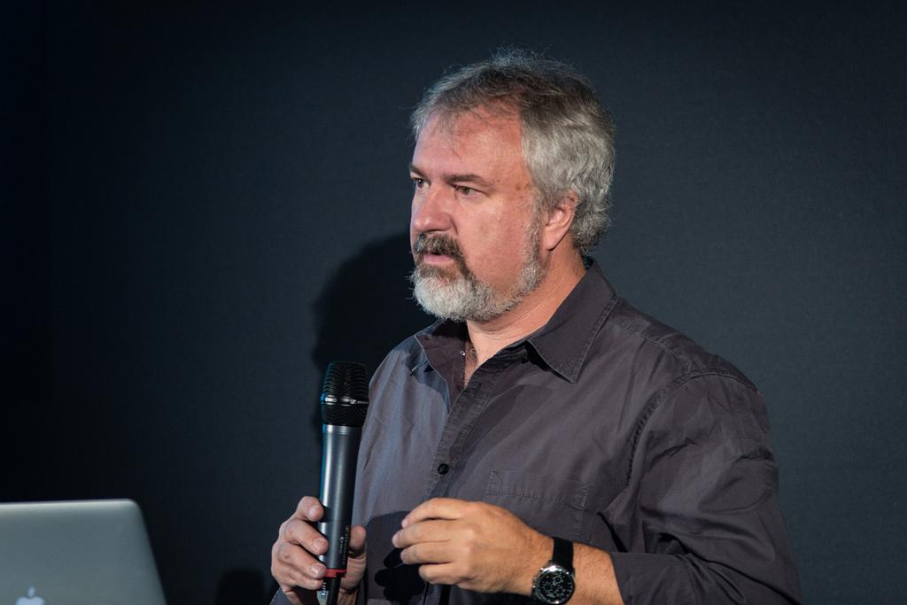
You are an @author who is responsible for communicating well with his readers.
Making it easy to read actually makes it easier to write.
“Clean code always looks like it was written by someone who cares.”
/ Michael Feathers /

Slide 36
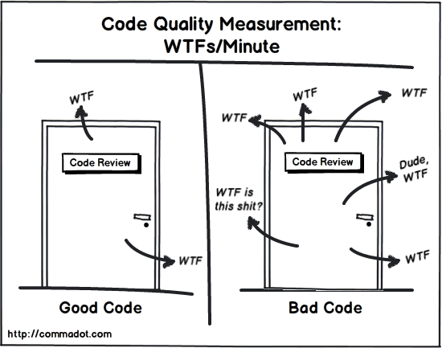
Clean Code principles

Slide 37
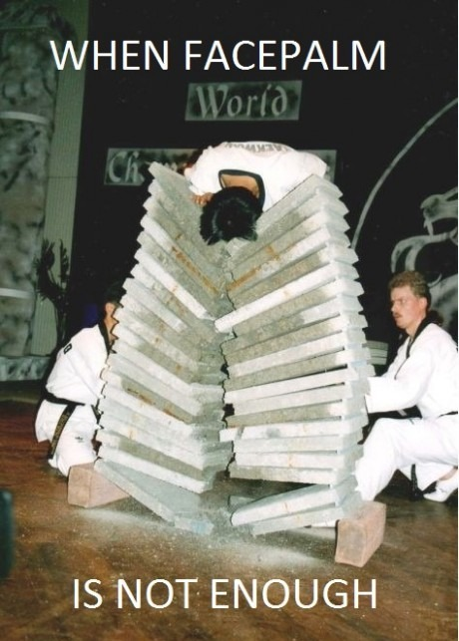

Slide 38
Meaningful names
reveal your intent
Notes:
It is already bad if you need to comment it or check the code for what is it used for
If a name requires a comment, then the name does not reveal its intent.

Slide 39
Meaningful names
reveal your intent
/** Useful range constant. */
public static final int INCLUDE_NONE = 0;
/** Useful range constant. */
public static final int INCLUDE_FIRST = 1;
/** Useful range constant. */
public static final int INCLUDE_SECOND = 2;
/** Useful range constant. */
public static final int INCLUDE_BOTH = 3;

Slide 40
Meaningful names
reveal your intent
/** Useful range constant. */
public static final int INCLUDE_NONE = 0;
/** Useful range constant. */
public static final int INCLUDE_FIRST = 1;
/** Useful range constant. */
public static final int INCLUDE_SECOND = 2;
/** Useful range constant. */
public static final int INCLUDE_BOTH = 3;
No shit, Sherlock!
Notes:
These comments are redundant and not helpful at all.

Slide 41
Meaningful names
reveal your intent
public enum DateInterval {
OPEN, CLOSED, OPEN_LEFT, OPEN_RIGHT
}
What about Enums?
Notes:
Easier to read, and probably in the source code will be easier to use.

Slide 42
Meaningful names
reveal your intent
public List<int[]> getThem() {
List<int[]> list1 = new ArrayList<int[]>();
for (int[] x : theList)
if (x[0] == 4)
list1.add(x);
return list1;
}

Slide 43
Meaningful names
reveal your intent
public List<int[]> getThem() {
List<int[]> list1 = new ArrayList<int[]>();
for (int[] x : theList)
if (x[0] == 4)
list1.add(x);
return list1;
}
WTF?!
Notes:
What is this for?

Slide 44
Meaningful names
reveal your intent
public List<int[]> getFlaggedCells() {
List<int[]> flaggedCells = new ArrayList<int[]>();
for (int[] cell : gameBoard)
if (cell[STATUS_VALUE] == FLAGGED)
flaggedCells.add(cell);
return flaggedCells;
}
Minesweeper
Notes:
Collecting flagged cells in a Minesweeper game.

Slide 45
Meaningful names
reveal your intent
public List<Cell> getFlaggedCells() {
List<Cell> flaggedCells = new ArrayList<Cell>();
for (Cell cell : gameBoard)
if (cell.isFlagged())
flaggedCells.add(cell);
return flaggedCells;
}
Minesweeper
Notes:
Why not using a Cell instead of an array? It is responsible for Cells and also increases readability.
One difference between a smart programmer and a professional programmer is that the professional understands that clarity is king. Professionals use their powers for good and write code that others can understand.

Slide 46
Meaningful names
reveal your intent
avoid disinformation
accountList -> accounts
Notes:
If ”accounts” is a collection you should not use List in the name.

Slide 47
Meaningful names
reveal your intent
avoid disinformation
add meaningful context

Slide 48
private void printGuessStatistics(char candidate, int count) {
String number;
String verb;
String pluralModifier;
if (count == 0) {
number = "no";
verb = "are";
pluralModifier = "s";
} else if (count == 1) {
number = "1";
verb = "is";
pluralModifier = "";
} else {
number = Integer.toString(count);
verb = "are";
pluralModifier = "s";
}
String guessMessage = String.format(
"There %s %s %s%s", verb, number, candidate, pluralModifier
);
print(guessMessage);
}
Meaningful names
reveal your intent
avoid disinformation
add meaningful context

Slide 49
public class GuessStatisticsMessage {
private String number;
private String verb;
private String pluralModifier;
public String make(char candidate, int count) {
createPluralDependentMessageParts(count);
return String.format("There %s %s %s%s",
verb, number, candidate, pluralModifier );
}
private void createPluralDependentMessageParts(int count) {
if (count == 0) {
thereAreNoLetters();
} else if (count == 1) {
thereIsOneLetter();
} else {
thereAreManyLetters(count);
}
}
private void thereAreManyLetters(int count) { .. }
private void thereIsOneLetter() { .. }
private void thereAreNoLetters() { .. }
}
Meaningful names
reveal your intent
avoid disinformation
add meaningful context

Slide 50
Meaningful names
reveal your intent
avoid disinformation
add meaningful context
parts of speech
if (employee.isLate())
employee.reprimand();

Slide 51
Meaningful names
reveal your intent
avoid disinformation
add meaningful context
parts of speech
getMockMvc().perform(mhsrb).andExpect(MockMvcResultMatchers.status().isBadRequest());
getMockMvc().perform(deleteRequest).andExpect(status().isBadRequest());

Slide 52
Meaningful names
reveal your intent
avoid disinformation
add meaningful context
parts of speech
public boolean set(String name, String value);
if (set("username","UserName")) {...}
Notes:
probably returns true if succeeded

Slide 53
Meaningful names
reveal your intent
avoid disinformation
add meaningful context
parts of speech
public void set(String name, String value) throw NotSetException {...}
public boolean isSet(String name) {...}
set("username","UserName");
if(isSet("username")) {...}
Rather throw exception if not succeeded,
and check the state later.
Notes:
probably returns true if succeeded

Slide 54
Meaningful names
reveal your intent
avoid disinformation
add meaningful context
parts of speech
pronounceable names

Slide 55
Meaningful names
reveal your intent
avoid disinformation
add meaningful context
parts of speech
pronounceable names
class DtaRcrd102 {
private Date genymdhms;
private Date modymdhms;
private final String pszqint = "102"; /* ... */
};
Notes:
How would you explain this to one of your colleague?
Like mhrs in our ITests

Slide 56
Meaningful names
reveal your intent
avoid disinformation
add meaningful context
parts of speech
pronounceable names
class Customer {
private Date generationTimestamp;
private Date modificationTimestamp;
private final String recordId = "102"; /* ... */
};

Slide 57
Meaningful names
reveal your intent
avoid disinformation
add meaningful context
parts of speech
pronounceable names
avoid mental mapping
Notes:
mental mapping like using one letters in for loops (i,j,k). It makes harder to read

Slide 58
Meaningful names
reveal your intent
avoid disinformation
add meaningful context
parts of speech
pronounceable names
avoid mental mapping
public static void copyChars(char a1[], char a2[]) {
for (int i = 0; i < a1.length; i++) {
a2[i] = a1[i];
}
}
Notes:
Number-series naming (a1, a2, .. aN)is the opposite of intentional naming. Such names are not disinformative—they are noninformative; they provide no clue to the author’s intention.

Slide 59
Meaningful names
reveal your intent
avoid disinformation
add meaningful context
parts of speech
pronounceable names
avoid mental mapping
public static void copyChars(char source[], char destination[]) {
for (int position = 0; position < source.length; position++) {
destination[position] = source[position];
}
}

Slide 60
Meaningful names
reveal your intent
avoid disinformation
add meaningful context
parts of speech
pronounceable names
avoid mental mapping
avoid encodings, prefixes and abrs
Notes:
They are also mental mappings.

Slide 61
Meaningful names
reveal your intent
avoid disinformation
add meaningful context
parts of speech
pronounceable names
avoid mental mapping
avoid encodings, prefixes and abbreviations
IAccounts
oAccount
m_variable
Notes:
They are also mental mappings. No need for Hungarian notations, I for interface or m_ for member variables. It adds an extra burden of deciphering. Your IDE will help you to know the details.

Slide 62
Meaningful names
reveal your intent
avoid disinformation
add meaningful context
parts of speech
pronounceable names
avoid mental mapping
avoid encodings, prefixes and abbreviations
use static factory methods when constructors are overloaded
Complex fulcrumPoint = new Complex(23.0);

Slide 63
Meaningful names
reveal your intent
avoid disinformation
add meaningful context
parts of speech
pronounceable names
avoid mental mapping
avoid encodings, prefixes and abbreviations
use static factory methods when constructors are overloaded
Complex fulcrumPoint = Complex.FromRealNumber(23.0);

Slide 64
Meaningful names
reveal your intent
avoid disinformation
add meaningful context
parts of speech
pronounceable names
avoid mental mapping
avoid encodings, prefixes and abbreviations
use static factory methods when constructors are overloaded
beware of using names which vary in small ways
XYZControllerForEfficientHandlingOfStrings XYZControllerForEfficientStorageOfStrings
Notes:
How much time does it take to spot the difference?

Slide 65
Meaningful names
reveal your intent
avoid disinformation
add meaningful context
parts of speech
pronounceable names
avoid mental mapping
avoid encodings, prefixes and abbreviations
use static factory methods when constructors are overloaded
beware of using names which vary in small ways
follow the Scope Rule
Notes:
- variables with short scopes can have short names, but with long scopes can have long names
- functions and classes with long scopes can have short names, but with short scopes can have long names
public method names should be short, but private method names can be long (they can be considered as comments)

Slide 66
Meaningful names
reveal your intent
avoid disinformation
add meaningful context
parts of speech
pronounceable names
avoid mental mapping
avoid encodings, prefixes and abbreviations
use static factory methods when constructors are overloaded
beware of using names which vary in small ways
follow the Scope Rule for(TestResult tr : configIssues) {
Element element = createElement(d, tr);
}
What is d?
Notes:
You need to read the whole method/class to figure out that d is a document.

Slide 67
Meaningful names
reveal your intent
avoid disinformation
add meaningful context
parts of speech
pronounceable names
avoid mental mapping
avoid encodings, prefixes and abbreviations
use static factory methods when constructors are overloaded
beware of using names which vary in small ways
follow the Scope Rule for(TestResult tr : configIssues) {
Element element = createElement(document, tr);
}
Notes:
Names should be long enough to fully communicate what something is or does without being so long that they become hard to read.

Slide 68
Functions
Small!
Notes:
Rule #1: Should be small! Rule #2: Smaller than that!
Functions should do 1 thing only. One level of abstraction per function.

Slide 69
Functions
Small! 4 lines
Notes:
4-6 lines without indenting. If else and while statements should be one line long, probably a function call.
Transform large functions to classes

Slide 70

Functions
Small! 4 lines
follow the Step Down Rule
public method
private method
private method
private method
Single Level of Abstraction
Notes:
We want the code to read like a top-down narrative. We want every function to be followed by those at the next level of abstraction so that we can read the program, descending one level of abstraction at a time as we read down a list of functions.
Public methods should tell what the class does (high level) and you should go down to low level abstractions if you need to know this details.
That’s already bad if you just want to know what a function does and need to go down to the how part.
Organize it vertically without backward referencing, do not scroll up for a new function
Staying at one level of abstraction increases readability.
One line of code can be on different levels of abstraction. If you assign a value to a variable you operate on a lower level of abstraction than a method call would be.

Slide 71
Functions
Small! 4 lines
follow the Step Down Rule
use descriptive names
Ward's principle:
"You know you are working on clean code when each routine turns out to be pretty much what you expected."
Notes:
A function should do one thing only and it should do it well.

Slide 72
Functions
Small! 4 lines
follow the Step Down Rule
use descriptive names
minimize arguments (use at most 3, no booleans or nulls)
Notes:
Arguments makes confusion and makes the function hard to read. If you would have more than 3 arguments use objects or setters. Unit tests will assure that the object state is complete.
Flag arguments are ugly, loudly proclaiming that this function does more than one thing.

Slide 73
Functions
Small! 4 lines
follow the Step Down Rule
use descriptive names
minimize arguments (use at most 3, no booleans or nulls)
includeSetupPageInto(newPageContent) -> includeSetupPage()
A detail revealed
Notes:
The argument is at a different level of abstraction than the function name and forces you to know a detail.

Slide 74
Functions
Small! 4 lines
follow the Step Down Rule
use descriptive names
minimize arguments (use at most 3, no booleans or nulls)
includeSetupPageInto(newPageContent) -> includeSetupPage()
assertEquals(message, expected, actual)
A detail revealed
How many times have you read the “message” and thought it was the “expected”?
Notes:
The order is not obvious.

Slide 75
Functions
Small! 4 lines
follow the Step Down Rule
use descriptive names
minimize arguments (use at most 3, no booleans or nulls)
avoid Switch statements
Notes:
It is hard to do it small and it does more things. It could be a dependency magnet.

Slide 76
Functions
public Money calculatePay(Employee e) throws InvalidEmployeeType {
switch (e.type) {
case COMMISIONED:
return calculateCommisionedPay(e);
case HOURLY:
return calculateHourlyPay(e);
case SALARIED:
return calculateSalariedPay(e);
default:
throw new InvalidEmployeeType(e.type);
}
}
Notes:
Violates Single responsibility and Open-Closed principles. You need to change to extend.
Probably there are other functions that have the same structure who depend on Employee.

Slide 77
Functions
public abstract class Employee {
public abstract Money calculatePay();
}
public interface EmployeeFactory {
public Employee makeEmployee(EmployeeRecord r) throws InvalidEmployeeType;
}
...
Notes:
Solution: Bury the switch statement into an Abstract Factory, and never let anyone see it.
Use base class instead and derive from it.

Slide 78
Functions
...
public class EmployeeFactoryImpl implements EmployeeFactory {
public Employee makeEmployee(EmployeeRecord r) throws InvalidEmployeeType {
switch (r.type) {
case COMMISIONED:
return new CommissionedEmployee(r);
case HOURLY:
return new HourlyEmployee(r);
case SALARIED:
return new SalariedEmployee(r);
default:
throw new InvalidEmployeeType(r.type);
}
}
}
Notes:
Solution: Bury the switch statement into an Abstract Factory, and never let anyone see it.
Use base class instead and derive from it.

Slide 79
Functions
Small! 4 lines
follow the Step Down Rule
use descriptive names
minimize arguments (use at most 3, no booleans or nulls)
avoid Switch statements
avoid side effects (use functional programming)
Notes:
Disinformation!
Temporal couplings are confusing, especially when hidden as a side effect. If you must have a temporal coupling, you should make it clear in the name of the function.
Temporal coupling: when you depend on a previous state in the system, like opening a file to process.

Slide 80
Functions
Small! 4 lines
follow the Step Down Rule
use descriptive names
minimize arguments (use at most 3, no booleans or nulls)
avoid Switch statements
avoid side effects (use functional programming)
public void open(File f, FileCommand c) {
f.open();
c.process(f);
f.close();
}
This will not depend on a
previous state of the system.
Notes:
You can avoid temporal coupling by passing a block.

Slide 81
Functions
Small! 4 lines
follow the Step Down Rule
use descriptive names
minimize arguments (use at most 3, no booleans or nulls)
avoid Switch statements
avoid side effects (use functional programming)
use Command Query Separation
Notes:
Functions should either do something or answer something, but not both.
Either your function should change the state of an object, or it should return some information about that object. Doing both often leads to confusion.

Slide 82
Functions
Small! 4 lines
follow the Step Down Rule
use descriptive names
minimize arguments (use at most 3, no booleans or nulls)
avoid Switch statements
avoid side effects (use functional programming)
use Command Query Separation
User u = authorizer.login(username, password);
if (u != null) {
..
}
Authorizer should know
the result of login.

Slide 83
Functions
Small! 4 lines
follow the Step Down Rule
use descriptive names
minimize arguments (use at most 3, no booleans or nulls)
avoid Switch statements
avoid side effects (use functional programming)
use Command Query Separation
authorizer.login(username, password);
if (authorizer.isLoggedIn()) {
..
}
Tell don’t ask!
Notes:
Tell don't ask: tell objects what to do, not to ask their states. no state checks, no exception handling outside to whom you talk

Slide 84
Functions
Small! 4 lines
follow the Step Down Rule
use descriptive names
minimize arguments (use at most 3, no booleans or nulls)
avoid Switch statements
avoid side effects (use functional programming)
use Command Query Separation
prefer (runtime) exceptions instead of returning error codes
Notes:
Returning error codes from command functions is a subtle violation of command query separation. It promotes commands being used as expressions in the predicates of if statements.
Runtime exceptions will not cause dependencies, like changing method declarations. Use unchecked exceptions for robust systems.
Runtime exceptions should be scoped within class.

Slide 85
Functions
Small! 4 lines
follow the Step Down Rule
use descriptive names
minimize arguments (use at most 3, no booleans or nulls)
avoid Switch statements
avoid side effects (use functional programming)
use Command Query Separation
prefer (runtime) exceptions instead of returning error codes
if (deletePage(page) == E_OK) {
...
}
Yikes!! Error processing could be
separated from the happy path
when you throw an exception.
Notes:
If you use exceptions instead of returned error codes, then the error processing code can be separated from the happy path code and can be simplified.
The price of checked exceptions is an Open/Closed Principle violation. If you throw a checked exception from a method in your code and the catch is three levels above, you must declare that exception in the signature of each method between you and the catch.
This means that a change at a low level of the software can force signature changes on many higher levels. The changed modules must be rebuilt and redeployed, even though nothing they care about changed.
Checked exceptions can sometimes be useful if you are writing a critical library: You must catch them.

Slide 86
Functions
Small! 4 lines
follow the Step Down Rule
use descriptive names
minimize arguments (use at most 3, no booleans or nulls)
avoid Switch statements
avoid side effects (use functional programming)
use Command Query Separation
prefer (runtime) exceptions instead of returning error codes
extract try-catch blocks
Notes:
Error handling is important, but if it obscures logic, it’s wrong.
Try/catch blocks are ugly in their own right. They confuse the structure of the code and mix error processing with normal processing. So it is better to extract the bodies of the try and catch blocks out into functions of their own.
Functions should do one thing. Error handling is one thing.
Your catch has to leave your program in a consistent state, no matter what happens in the try. For this reason it is good practice to start with a try-catch-finally statement when you are writing code that could throw exceptions. This helps you define what the user of that code should expect, no matter what goes wrong with the code that is executed in the try.

Slide 87
Functions
Small! 4 lines
follow the Step Down Rule
use descriptive names
minimize arguments (use at most 3, no booleans or nulls)
avoid Switch statements
avoid side effects (use functional programming)
use Command Query Separation
prefer (runtime) exceptions instead of returning error codes
extract try-catch blocks
never return null
Unless you are a
NullPointerException
pervert!
Notes:
There are some rare cases, but it will cause NullPointerException somewhere in your system.
You also will check nulls in every second line in a function.

Slide 88
Functions
Small! 4 lines
follow the Step Down Rule
use descriptive names
minimize arguments (use at most 3, no booleans or nulls)
avoid Switch statements
avoid side effects (use functional programming)
use Command Query Separation
prefer (runtime) exceptions instead of returning error codes
extract try-catch blocks
never return null
avoid early exiting loops
Notes:
“break” and “continue” makes harder to understand the loop.

Slide 89
Functions
Small! 4 lines
follow the Step Down Rule
use descriptive names
minimize arguments (use at most 3, no booleans or nulls)
avoid Switch statements
avoid side effects (use functional programming)
use Command Query Separation
prefer (runtime) exceptions instead of returning error codes
extract try-catch blocks
never return null
avoid early exiting loops
DRY (Don’t Repeat Yourself)
Forget copy-paste
programming.
Notes:
In any particular system, any piece of information should, ideally, exist only once.
Duplication may be the root of all evil in software.
It is probably one of the principles ignored mostly. Nothing is easier than to reuse code by copying and pasting.
Duplication is the primary enemy of a well-designed system. It represents additional work, additional risk, and additional unnecessary complexity.

Slide 90

Functions
Small! 4 lines
follow the Step Down Rule
use descriptive names
minimize arguments (use at most 3, no booleans or nulls)
avoid Switch statements
avoid side effects (use functional programming)
use Command Query Separation
prefer (runtime) exceptions instead of returning error codes
extract try-catch blocks
never return null
avoid early exiting loops
DRY (Don’t Repeat Yourself)
KISS (Keep It Simple, Stupid)
Notes:
It should ring some alarm bells if your if you are not able to understand code anymore that you wrote yourself just a few weeks ago. It is even more important to make your code understandable to other developers.

Slide 91
Comments
“Don’t comment bad code—rewrite it.” —Brian W. Kernighan and P. J. Plaugher
Notes:
Nothing can be quite so helpful as a well-placed comment. Nothing can clutter up a module more than frivolous dogmatic comments. Nothing can be quite so damaging as an old crufty comment that propagates lies and misinformation.

Slide 92
Comments
“Don’t comment bad code—rewrite it.”
comments are failures of expressing yourself with code
Avoid them! Ignore them! Remove them!
Notes:
The proper use of comments is to compensate for our failure to express ourselves in code. Note that I used the word failure. I meant it. Comments are always failures
Use it as a last resort.
Only if you can’t make code simpler should you have a comment explaining what it does.

Slide 93
Comments
“Don’t comment bad code—rewrite it.”
comments are failures of expressing yourself with code
inaccurate comments are far worse than no comments at all
Notes:
Code changes and evolves. Unfortunately the comments don’t always follow them—can’t always follow them. Inaccurate comments are far worse than no comments at all. They delude and mislead.

Slide 94
Comments
“Don’t comment bad code—rewrite it.”
comments are failures of expressing yourself with code
inaccurate comments are far worse than no comments at all
Rather than spend your time writing the comments that explain the mess you’ve made, spend it cleaning that mess.

Slide 95
Comments
“Don’t comment bad code—rewrite it.”
comments are failures of expressing yourself with code
inaccurate comments are far worse than no comments at all
Rather than spend your time writing the comments that explain the mess you’ve made, spend it cleaning that mess.
use functions or a variables instead of comments
// Check to see if the employee is eligible for full benefits
if ((employee.flags & HOURLY_FLAG) && (employee.age > 65))
Notes:
Which one would you rather see?

Slide 96
Comments
“Don’t comment bad code—rewrite it.”
comments are failures of expressing yourself with code
inaccurate comments are far worse than no comments at all
Rather than spend your time writing the comments that explain the mess you’ve made, spend it cleaning that mess.
use functions or a variables instead of comments
if (employee.isEligibleForFullBenefits())
Notes:
Which one would you rather see?

Slide 97
Comments
“Don’t comment bad code—rewrite it.”
comments are failures of expressing yourself with code
inaccurate comments are far worse than no comments at all
Rather than spend your time writing the comments that explain the mess you’ve made, spend it cleaning that mess.
use functions or a variables instead of comments
remove commented-out code
Notes:
Others who see that commented-out code won’t have the courage to delete it. They’ll think it is there for a reason and is too important to delete. So commented-out code gathers like dregs at the bottom of a bad bottle of wine. Use version control!

Slide 98
Comments
“Don’t comment bad code—rewrite it.”
comments are failures of expressing yourself with code
inaccurate comments are far worse than no comments at all
Rather than spend your time writing the comments that explain the mess you’ve made, spend it cleaning that mess.
use functions or a variables instead of comments
remove commented-out code
no position markers, no html comments
Notes:
NO COPY-PASTE COMMENTS PLEEEEASE!!!!

Slide 99
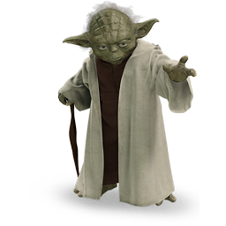
Comments
“Don’t comment bad code—rewrite it.”
comments are failures of expressing yourself with code
inaccurate comments are far worse than no comments at all
Rather than spend your time writing the comments that explain the mess you’ve made, spend it cleaning that mess.
use functions or a variables instead of comments
remove commented-out code
no position markers, no html comments
no TODO comments
Remember:
later = NEVER
Notes:
We will fix it later...

Slide 100
Comments
“Don’t comment bad code—rewrite it.”
comments are failures of expressing yourself with code
inaccurate comments are far worse than no comments at all
Rather than spend your time writing the comments that explain the mess you’ve made, spend it cleaning that mess.
use functions or a variables instead of comments
remove commented-out code
no position markers, no html comments
no TODO comments
good comments: legal comments informative comments (regexp) clarification, warning of consequences javadoc
Notes:
clarification - if you can not alter your code and need to be explained, like using a library
warning of consequences - not thread safe, or long running
javadoc - in public APIs

Slide 101
Classes
Small!
Notes:
Small files are usually easier to understand than large files are.
Think of a well-written newspaper article. You read it vertically. At the top you expect a headline that will tell you what the story is about and allows you to decide whether it is something you want to read. The first paragraph gives you a synopsis of the whole story, hiding all the details while giving you the broad-brush concepts. As you continue downward, the details increase until you have all the dates, names, quotes, claims, and other minutia.
Concepts that are closely related should be kept vertically close to each other
We want to avoid forcing our readers to hop around through our source files and classes.
Dependent Functions. If one function calls another, they should be vertically close, and the caller should be above the callee, if at all possible. This gives the program a natural flow. If the convention is followed reliably, readers will be able to trust that function definitions will follow shortly after their use.

Slide 102
Classes
Small! 1 responsability
Notes:
Should have one responsibility. The name of a class should describe what responsibilities it fulfills. If we cannot derive a concise name for a class, then it’s likely too large
The Single Responsibility Principle
Classes should have one responsibility—one reason to change. SRP is one of the more important concept in OO design. It’s also one of the simpler concepts to understand and adhere to.
Every sizable system will contain a large amount of logic and complexity. The primary goal in managing such complexity is to organize it so that a developer knows where to look to find things and need only understand the directly affected complexity at any given time. In contrast, a system with larger, multipurpose classes always hampers us by insisting we wade through lots of things we don’t need to know right now.
Getting software to work and making software clean are two very different activities.

Slide 103


Classes
Small! 1 responsability
high cohesion, low coupling
Notes:
A class in which each variable is used by each method is maximally cohesive. When cohesion is high, it means that the methods and variables of the class are co-dependent and hang together as a logical whole.
A client class depending upon concrete details is at risk when those details change. We can introduce interfaces and abstract classes to help isolate the impact of those details.
The lack of coupling means that the elements of our system are better isolated from each other and from change. This isolation makes it easier to understand each element of the system.
By minimizing coupling in this way, our classes adhere to another class design principle known as the Dependency Inversion Principle (DIP). In essence, the DIP says that our classes should depend upon abstractions, not on concrete details.
Tight coupling makes your system hard to write, to test, to change or maintain and leads to code rot with always changing requirements
We also should collect classes and interfaces into the same component what change for the same reason.

Slide 104
Classes
Small! 1 responsability
high cohesion, low coupling
don’t talk to strangers - Law of Demeter
o.getX().getY().doSomething() -> o.doSomething()
Notes:
A module should not know about the innards of the objects it manipulates.
Objects hide their data and expose operations. This means that an object should not expose its internal structure through accessors because to do so is to expose, rather than to hide, its internal structure.
Law of Demeter says that a method f of a class C should only call the methods of these:
•C (same class)
•An object created by method f
•An object passed as an argument to method f
•An object held in an instance variable of class C
The method should not invoke methods on objects that are returned by any of the allowed functions. In other words, talk to friends, not to strangers.

Slide 105
Classes
Small! 1 responsability
high cohesion, low coupling
don’t talk to strangers - Law of Demeter
Options opts = ctxt.getOptions();
File scratchDir = opts.getScratchDir();
final String outputDir = scratchDir.getAbsolutePath();
Train Wrecks!
Notes:
Train Wrecks
Chains of calls like this are generally considered to be sloppy style and should be avoided
The containing module knows that the ctxt object contains options, which contain a scratch directory, which has an absolute path. That’s a lot of knowledge for one function to know. The calling function knows how to navigate through a lot of different objects.
If they are objects, then their internal structure should be hidden rather than exposed, and so knowledge of their innards is a clear violation of the Law of Demeter. On the other hand, if ctxt, Options, and ScratchDir are just data structures with no behavior, then they naturally expose their internal structure, and so Demeter does not apply.

Slide 106
Classes
Small! 1 responsability
high cohesion, low coupling
don’t talk to strangers - Law of Demeter
Options opts = ctxt.getOptions();
File scratchDir = opts.getScratchDir();
final String outputDir = scratchDir.getAbsolutePath();
...
String outFile = outputDir + "/" + className.replace('.', '/') + ".class";
FileOutputStream fout = new FileOutputStream(outFile);
BufferedOutputStream bos = new BufferedOutputStream(fout);
Train Wrecks!
Notes:
If ctxt is an object, we should be telling it to do something; we should not be asking it about its internals. So why did we want the absolute path of the scratch directory? What were we going to do with it? Consider this code from (many lines farther down in) the same module...

Slide 107
Classes
Small! 1 responsability
high cohesion, low coupling
don’t talk to strangers - Law of Demeter
Options opts = ctxt.getOptions();
File scratchDir = opts.getScratchDir();
final String outputDir = scratchDir.getAbsolutePath();
...
String outFile = outputDir + "/" + className.replace('.', '/') + ".class";
FileOutputStream fout = new FileOutputStream(outFile);
BufferedOutputStream bos = new BufferedOutputStream(fout);
Train Wrecks!

Slide 108
Classes
Small! 1 responsability
high cohesion, low coupling
don’t talk to strangers - Law of Demeter
BufferedOutputStream bos = ctxt.createScratchFileStream(classFileName);
Notes:
So, what if we told the ctxt object to do this?
That seems like a reasonable thing for an object to do! This allows ctxt to hide its internals and prevents the current function from having to violate the Law of Demeter by navigating through objects it shouldn’t know about.

Slide 109
Classes
Small! 1 responsability
high cohesion, low coupling
don’t talk to strangers - Law of Demeter
make it SOLID

Slide 110
Classes
Small! 1 responsability
high cohesion, low coupling
don’t talk to strangers - Law of Demeter
make it SOLID
Single responsibility principle
Notes:
A class which is responsible for exactly one thing is easier to understand than a big general store.
Violating the Single Responsibility principle leads to high coupling which means higher complexity (difficult to understand and to maintain)
i.e.:no business rules in stored procedures
no sql queries with html
no logic with output formatting
no logging with defining logic (but this can be in inner classes -> separation of responsibility is not necessary about separation of source code)

Slide 111
Classes
Small! 1 responsability
high cohesion, low coupling
don’t talk to strangers - Law of Demeter
make it SOLID
Single responsibility principle
Open-closed principle
Notes:
A software module should be opened for extension (change/extend the behaviour) but closed for modification (without changing the source code)
-if a code will not be changed it could not rot
-not easy but it matters of size
-not need to recompile the dependencies
-makes the system less rigid and less fragile, preserves the system’s stability
-how would you extend? with ifs, make it even harder to maintain?

Slide 112
Classes
Small! 1 responsability
high cohesion, low coupling
don’t talk to strangers - Law of Demeter
make it SOLID
Single responsibility principle
Open-closed principle
Liskov substitution principle
Notes:
Objects in a program should be replaceable with instances of their subtypes without altering the correctness of that program.
If S is a subtype of T, then objects of type T may be replaced with objects of type S. Every type can be replaced with its subtype, because subtype stands in “is a” relationship with type (subtype is a type).
Use a Type to operations on data.
Subtypes can be used as their parent types, but not in the other way around (asymmetry)
Duck typing: if it walks like a duck and quacks like a duck.. that's a duck, even if it is a different implementation
A subtype can do more than it's parent type, but it cannot do less. (If you not throw an exception in a Type all the Subtypes should not throw exception. Otherwise it could break the system if you do not expect that)

Slide 113
Classes
Small! 1 responsability
high cohesion, low coupling
don’t talk to strangers - Law of Demeter
make it SOLID
Single responsibility principle
Open-closed principle
Liskov substitution principle
Type-case is a violation of this principle:
if (shape instanceof Shape) ...
else if (shape instanceof Square) ...
else if (shape instanceof Rectangle) ...
Notes:
Type-case: you depend on subtype behaviours

Slide 114
Classes
Small! 1 responsability
high cohesion, low coupling
don’t talk to strangers - Law of Demeter
make it SOLID
Single responsibility principle
Open-closed principle
Liskov substitution principle
Interface segregation principle
Notes:
Many client-specific interfaces are better than one general-purpose interface.
Don’t depend on things you don’t need.
States that no client should be forced to depend on methods it does not use. ISP splits interfaces which are very large into smaller and more specific ones so that clients will only have to know about the methods that are of interest to them.
Use multiple interface inheritance so it will prevent to recompile classes what are not involved in an interface change (SRP)
With this you can prevent fat classes and backward coupling by preventing implementing methods what you don’t call (prevents your system to become rigid and fragile)

Slide 115
Classes
Small! 1 responsability
high cohesion, low coupling
don’t talk to strangers - Law of Demeter
make it SOLID
Single responsibility principle
Open-closed principle
Liskov substitution principle
Interface segregation principle
Dependency inversion principle
Notes:
Depend upon Abstractions. Do not depend upon concretions.
A. High-level modules should not depend on low-level modules. Both should depend on abstractions. B. Abstractions should not depend on details. Details should depend on abstractions.
Depending on interface or any abstraction will prevent compile time dependencies. (Information hiding)
Implementation (like plugins) should not know about who is calling or using it. This is how you can use Mocks in unit tests.

Slide 116
Classes
Small! 1 responsability
high cohesion, low coupling
don’t talk to strangers - Law of Demeter
make it SOLID
favor composition over inheritance
Notes:
Object-Oriented Programing (OOP) has two well known candidates for the reuse of functionality: Inheritance (whitebox reuse) and Composition (blackbox reuse). If you try to reuse code by inheriting from a class you will make the subclass dependent on the parent class. This makes a system in many cases unnecessarily complex, less testable and makes the exchange of functionality at run time unnecessarily hard.

Slide 117
Classes
Small! 1 responsability
high cohesion, low coupling
don’t talk to strangers - Law of Demeter
make it SOLID
favor composition over inheritance
YAGNI (You Ain’t Gonna Need It)
Notes:
Don’t waste time for thing you don’t need.
Another risk of writing code before you need it is that unused code tends to develop “bit rot.” Since the code never runs, it might slowly become out of sync with the rest of your system and thus develop bugs, and you’ll never know. It brings unneeded complexity to the system.
There are two ways to get a rigid design: 1.Make too many assumptions about the future. 2.Write code without enough design.
Implement only the clear features and only in the priority order established by the customer.

Slide 118
Classes
Small! 1 responsability
high cohesion, low coupling
don’t talk to strangers - Law of Demeter
make it SOLID
favor composition over inheritance
YAGNI (You Ain’t Gonna Need It)
beware of optimizations
Notes:
Optimizations are always expensive. Optimized code is often anything but readable. 'Premature optimization is the root of all evil.'

Slide 119
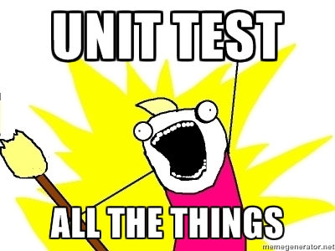
Unit tests
as important as production code (documentation)
Notes:
Without tests every change is a possible bug. If you have tests, you do not fear making changes to the code! Otherwise you will fear to clean the code and it will rot what will slows you down.
People thinks it slows you down, but it saves you time from debugging and fixing bugs. (saves us from debugging what is time consuming and cumbersome)
In a test you want to say a lot with as few expressions as possible. It is also a documentation of your software

Slide 120
Unit tests
as important as production code (documentation)
use domain-specific testing language
public void testGetDataAsXml() throws Exception {
makePageWithContent("TestPageOne", "test page");
submitRequest("TestPageOne", "type:data");
assertResponseIsXML();
assertResponseContains("test page", "<Test");
}
Notes:
Rather than using the APIs that programmers use to manipulate the system, we build up a set of functions and utilities that make use of those APIs and that make the tests more convenient to write and easier to read.
Unit tests could be harder to read because it could have many things in one test (preparations and assertions)

Slide 121
Unit tests
as important as production code (documentation)
use domain-specific testing language
single concept per test
Notes:
test a single concept in each test function.
Merging them all together into the same function forces the reader to figure out why each section is there and what is being tested by that section.
It also helps you spot what went wrong in your system.

Slide 122
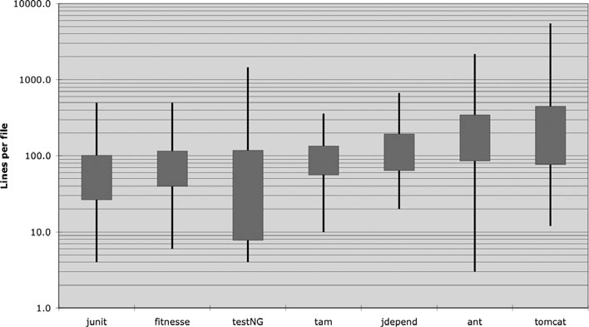
Unit tests
as important as production code (documentation)
use domain-specific testing language
single concept per test
TDD leads to better design
Notes:
With tdd you will write only that much production code as much as it is needed.
TDD helps you design a decoupled system.
In the chart you can see some projects. At the left you can see projects with less average filesize. Those were developed by TDD. Moving to the right the projects were using less TDD.

Slide 123
Unit tests
as important as production code (documentation)
use domain-specific testing language
single concept per test
TDD leads to better design
The 3 laws of TDD:
You may not write production code until you have written a failing unit test.

Slide 124
Unit tests
as important as production code (documentation)
use domain-specific testing language
single concept per test
TDD leads to better design
The 3 laws of TDD:
You may not write production code until you have written a failing unit test.
You may not write more of a unit test than is sufficient to fail, and not compiling is failing.

Slide 125
Unit tests
as important as production code (documentation)
use domain-specific testing language
single concept per test
TDD leads to better design
The 3 laws of TDD:
You may not write production code until you have written a failing unit test.
You may not write more of a unit test than is sufficient to fail, and not compiling is failing.
You may not write more production code than is sufficient to pass the currently failing test.

Slide 126
Unit tests
as important as production code (documentation)
use domain-specific testing language
single concept per test
TDD leads to better design
The 3 laws of TDD:
You may not write production code until you have written a failing unit test.
You may not write more of a unit test than is sufficient to fail, and not compiling is failing.
You may not write more production code than is sufficient to pass the currently failing test.
+1: Refactor (Red-Green-Refactor)
Notes:
Refactoring is not a nice-to-have option. It is mandatory part of TDD. It makes your code cleaner, easier to understand and DRY. This is the point.

Slide 127
Unit tests
as important as production code (documentation)
use domain-specific testing language
single concept per test
TDD leads to better design
follow the Boy Scout Rule
Notes:
Always leave the campground cleaner than you found it. It works against the Broken Windows Theory

Slide 128
Unit tests
as important as production code (documentation)
use domain-specific testing language
single concept per test
TDD leads to better design
follow the Boy Scout Rule
test FIRST
Notes:
Clean tests follow five other rules that form the above acronym

Slide 129
Unit tests
as important as production code (documentation)
use domain-specific testing language
single concept per test
TDD leads to better design
follow the Boy Scout Rule
test FIRST
Fast
Notes:
Fast: If you don’t run them frequently, you won’t find problems early enough to fix them easily

Slide 130
Unit tests
as important as production code (documentation)
use domain-specific testing language
single concept per test
TDD leads to better design
follow the Boy Scout Rule
test FIRST
Fast
Independent
Notes:
Independent: One test should not set up the conditions for the next test. You should be able to run each test independently and run the tests in any order you like.

Slide 131
Unit tests
as important as production code (documentation)
use domain-specific testing language
single concept per test
TDD leads to better design
follow the Boy Scout Rule
test FIRST
Fast
Independent
Repeatable
Notes:
Repeatable: If your tests aren’t repeatable in any environment, then you’ll always have an excuse for why they fail.

Slide 132
Unit tests
as important as production code (documentation)
use domain-specific testing language
single concept per test
TDD leads to better design
follow the Boy Scout Rule
test FIRST
Fast
Independent
Repeatable
Self-validating
Notes:
Self-Validating: The tests should have a boolean output. Either they pass or fail. You should not have to read through a log file to tell whether the tests pass.

Slide 133
Unit tests
as important as production code (documentation)
use domain-specific testing language
single concept per test
TDD leads to better design
follow the Boy Scout Rule
test FIRST
Fast
Independent
Repeatable
Self-validating
Timely
Notes:
Timely: Unit tests should be written just before the production code that makes them pass. If you write tests after the production code, then you may find the production code to be hard to test. You may decide that some production code is too hard to test. You may not design the production code to be testable.

Slide 134
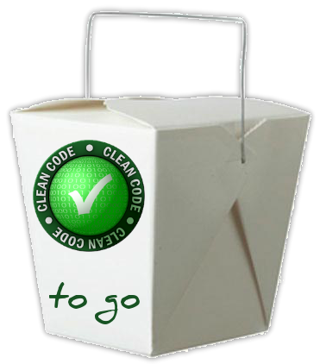
Takeaways
“Complexity kills. It sucks the life out of developers, it makes products difficult to plan, build, and test.”
—Ray Ozzie, CTO, Microsoft Corporation
Notes:
complexity brings down productivity

Slide 135
Takeaways
“Complexity kills. It sucks the life out of developers, it makes products difficult to plan, build, and test.”
Clarity is king!

Slide 136
Takeaways
“Complexity kills. It sucks the life out of developers, it makes products difficult to plan, build, and test.”
Clarity is king!
don’t save (your) time on namings

Slide 137
Takeaways
“Complexity kills. It sucks the life out of developers, it makes products difficult to plan, build, and test.”
Clarity is king!
don’t save (your) time on namings
read less, write more

Slide 138
Takeaways
“Complexity kills. It sucks the life out of developers, it makes products difficult to plan, build, and test.”
Clarity is king!
don’t save (your) time on namings
read less, write more
No comments!

Slide 139
Takeaways
“Complexity kills. It sucks the life out of developers, it makes products difficult to plan, build, and test.”
Clarity is king!
don’t save (your) time on namings
read less, write more
No comments!
DRY, KISS, YAGNI, SOLID, TDD, FIRST
Notes:
not just write tests, but do TDD

Slide 140
Takeaways
“Complexity kills. It sucks the life out of developers, it makes products difficult to plan, build, and test.”
Clarity is king!
don’t save (your) time on namings
read less, write more
No comments!
DRY, KISS, YAGNI, SOLID, TDD, FIRST
refactoring is not a nice-to-have option
Notes:
take your time to rephrase what you want to express by code

Slide 141
Takeaways
“Complexity kills. It sucks the life out of developers, it makes products difficult to plan, build, and test.”
Clarity is king!
don’t save (your) time on namings
read less, write more
No comments!
DRY, KISS, YAGNI, SOLID, TDD, FIRST
refactoring is not a nice-to-have option
later = NEVER

Slide 142
Takeaways
“Complexity kills. It sucks the life out of developers, it makes products difficult to plan, build, and test.”
Clarity is king!
don’t save (your) time on namings
read less, write more
No comments!
DRY, KISS, YAGNI, SOLID, TDD, FIRST
refactoring is not a nice-to-have option
later = NEVER
always improve
Notes:
improve yourself: read books (at least 6/year), read blogs, go to conferences, watch videos, talk to others, learn
improve the code: when you improved your skills return and improve your code as well

Slide 143
Takeaways
“Complexity kills. It sucks the life out of developers, it makes products difficult to plan, build, and test.”
Clarity is king!
don’t save (your) time on namings
read less, write more
No comments!
DRY, KISS, YAGNI, SOLID, TDD, FIRST
refactoring is not a nice-to-have option
later = NEVER
always improve
Boy Scout Rule
Notes:
improve yourself: read books (at least 6/year), read blogs, go to conferences, watch videos, talk to others, learn
improve the code: when you improved your skills return and improve your code as well

Slide 144
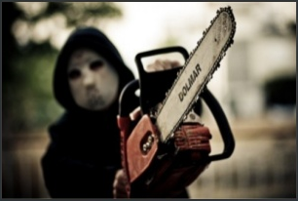
Code for humans, not machines
Think that the next person who reads your code is a chainsaw maniac.
If you don’t write clean code, you know your fate.

Slide 145
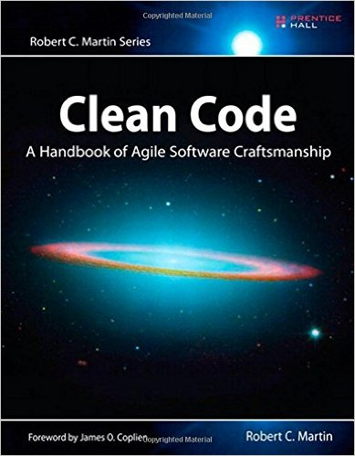
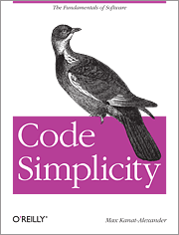
Resources
Robert C. Martin: Clean code - A handbook of Agile Software Craftsmanship
Max Kanat-Alexander: Code Simplicity
www.cleancoders.com
www.clean-code-developer.hu (.de)
Clean Code cheat sheet
The essence of „Clean Code”

Slide 146

Your powerful partner

Slide 147
Counterpart
Zoltán Domahidi
O2.10 / Java Developer
Email: Zoltan.Domahidi@evosoft.com

